Slide 1

CIRM-GMS
Automation Test Strategy

Slide 2
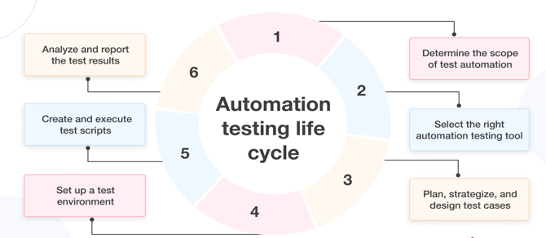
Test Strategy

Slide 3
Scope of Test Automation
Application modules that are to be automated
Test cases that need automation
Approaches to automate those test cases
Right tools for automation testing
Implementation cost, available resources, and skills

Slide 4
Selecting Automation Testing Tool
Essential to keep the cost in mind.
Should know the available skillset.
Tools should match the technical expertise in the team.
Automation Testing tools are:
Selenium
Cypress
Excelencia Framework

Slide 5
Plan, strategy, and Design the Test cases
Collect
Collect all manual test cases from test management tools and identify the test cases that can automate
Study
Study the pros and cons of testing frameworks before determining the best one for the project requirements
Build
Build a test suite for automation testing
Understand
Understand the risk and dependencies between testing tools and your application

Slide 6
Setup the Test Environment
Feed the data into a test environment closely aligned with production data
Build a list of systems, modules, and applications you need to test
Conduct tests on various browsers, operating systems, and devices
Test application under low and high network conditions to understand rendering time
Keep all the documentation related to testing in one centralized repository

Slide 7
Create and Execute the Test Script
Test scripts should take their basis on actual project requirements
Use a standard testing method throughout the project
Test scripts should be simple, reusable, and easy to understand
You should thoroughly review the code in the test script
A test script should have all the functional aspects
The test script should run on various environments and platforms
Try to execute test scripts in a batch manner to save time and resources
There should be a bug report in case of any errors

Slide 8
Report the Test Result
Should document and analyze the results to identify the issues that occurred during a particular test case.
Create an in-depth report about the behavior of various test cases under specific conditions.
These will help us to know the application’s areas that still require improvement.
Share the test reports with all stakeholders to keep transparency.

Slide 9

Thank You !

